Slide 1
Movies’ sales : predicting box office and understanding customers’ preferences.
Carola Spinelli 500938948

Slide 2
Dataset and project relevance
Dataset = sales
Stakeholder = movie producers
predict potential box office for upcoming films accurately and understanding customers’ preference can increase revenue → investment decisions
"How can movie producers increase their revenue by predicting the box office of upcoming movies and understanding audience preferences?

Slide 3
Research question and methodology
Supervised (Random Forest & ANN) Unsupervised (Clustering)
1) Which model is the most adequate for this business case?
2) What are the most important predictors of movies' box office?
3) What is the relationship between these predictors and the predicted box office?
1) What is the most adequate clustering method for this business case?
2) Which features can provide insights into audience preferences?
3) What can movie producers imply from these features?

Slide 4
Feature engineering
Title length (from title)
Market potential (theatre count * production budget)

Slide 5
Supervised Learning

Slide 6
Random Forest
Mean Squared Error (MSE) after tuning: 4.81
Mean Absolute Error (MAE) after tuning: 1.66
R-squared after tuning: 0.25
Mean CV Score After Tuning: 4.95

Slide 7
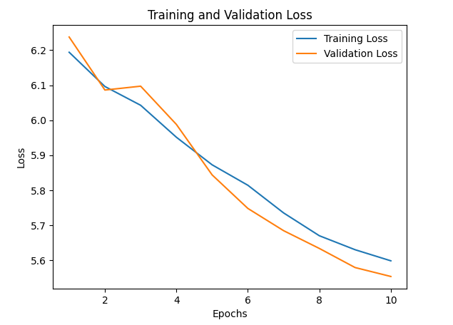
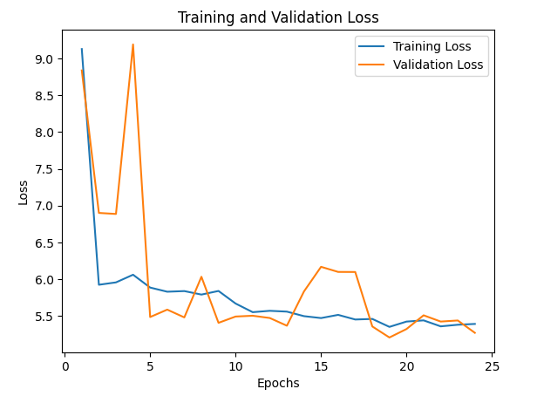
ANN
Relu activation function
Mean Squared Error (MSE) after tuning: 5.50
R-squared (R2) after tuning: 0.18
Mean Absolute Error (MAE) after tuning: 1.79

Slide 8
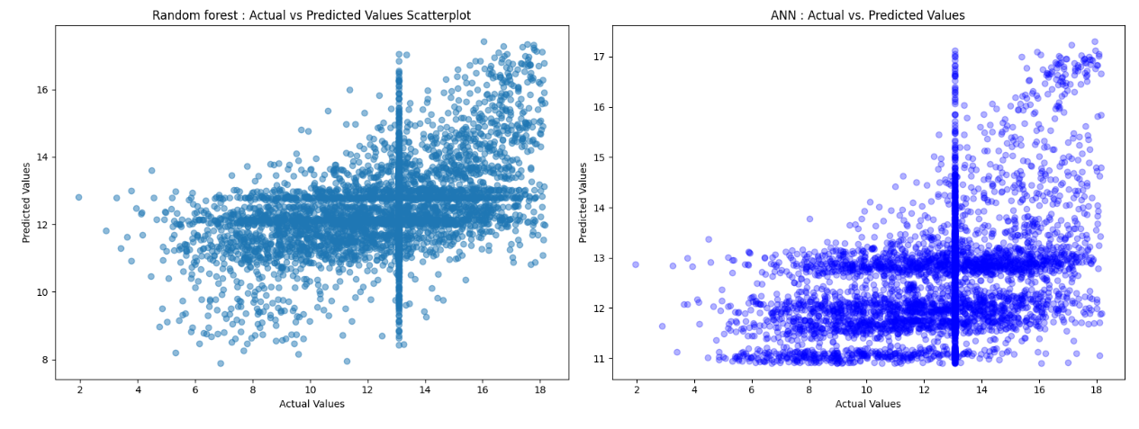
Random forest & ANN performance
Random Forest was the best performing model.

Slide 9
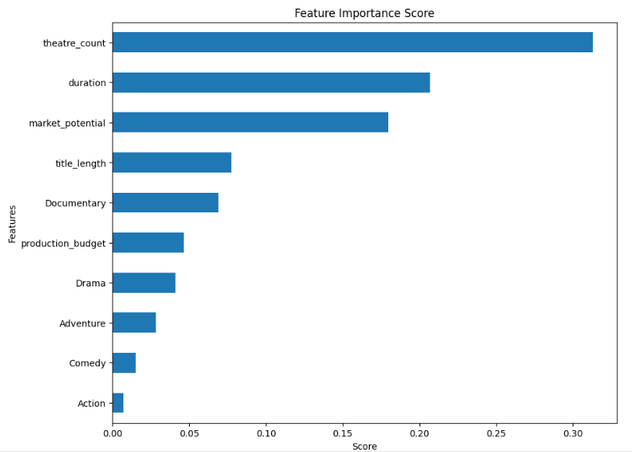
Explainability (Random Forest)
ALE

Slide 10
Answers for supervised learning (1)
1) Which model is the most adequate for this business case?
Random Forest
2) What are the most important predictors of movies' box office?
Theatre count, duration, market potential

Slide 11
Answers for supervised learning (2)
3) What is the relationship between these predictors and the predicted box office?
Theatre count = Positive
Duration = For short duration movies negative, for above average duration positive but till a certain extent
Market potential = For movie with low market potential negative, for movie with high market potential positive
Title length = Positive except for exceptionally long titles
Production budget = Negative expect for movies with the highest production budgets
Documentary, Drama = Negative
Adventure, Comedy, Action = Positive

Slide 12
Unsupervised Learning

Slide 13
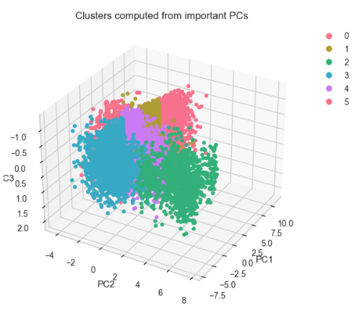
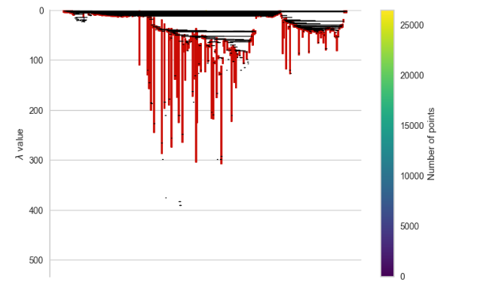
3 clustering models
K means on important PCs = 6 clusters (elbow method)
DBSCAN = 3 clusters (elbow method)
HDBSCAN = 228 clusters (due to hierarchical clustering, where clusters are formed at different density levels)
All analysed on Silhouette and DBI score

Slide 14
Best clustering model : K means
Silhouette and DBI scores for different clustering methods.
- Kmeans
Silhouette Score: 0.464277
DBI: 0.688136
- DBSCAN
Silhouette Score: -0.00462
DBI: 4.560915
- HDBSCAN
Silhouette Score: -0.46701
DBI: 2.203799

Slide 15
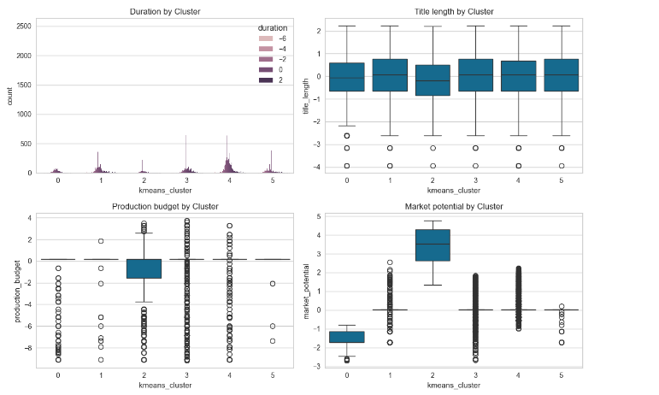
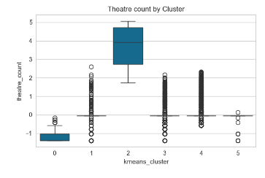
Clustering summary

Slide 16
Answers for unsupervised learning
1) What is the most adequate clustering method for this business case? Among the three clustering methods, K-means on PCs performs the best.
2) Which features can provide insights into audience preferences? Movies' production budget, theatre count, and market potential (so a combination of these features) are significant factors in distinguishing between movies' clusters. They are relevant for understanding audience's preferences.
3) What else can movie producers imply from the clustering analysis? Features like title length and movies’ duration are less relevant for understanding audience's preferences.

Slide 17
Implications for movies’ stakeholders
"How can movie producers increase their revenue by predicting the box office of upcoming movies and understanding audience preferences?
Invest in movies that are gonna be displayed in multiple theatres
Invest in average length or slightly above average movies
Invest in movies with high market potential
Invest in movies with whatever title length expect exceptionally long titles
Invest in movies with above average production budgets
Invest on movies with genres such as adventure, comedy or action rather than Documentaries of Drama movies.
Focus on segmentation strategies based on movie’s production budget, theatre count (and market potential) to target audiences more effectively.

Slide 18
Thank you!

